Slide 1
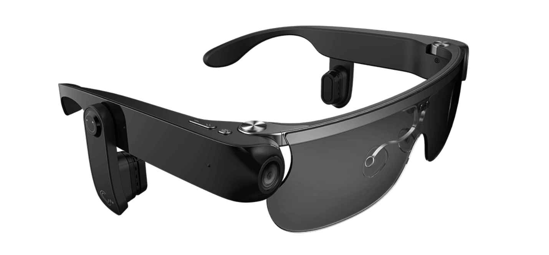
visual-assist glasses
Team members
Lihan Zhao
Tianlei Shi
Xingbo Wei
Hening Fan
Zhichao Ma

Slide 2


One-piece
Separated
Heavy
Inconvenient
lighter weight
convenient

Slide 3
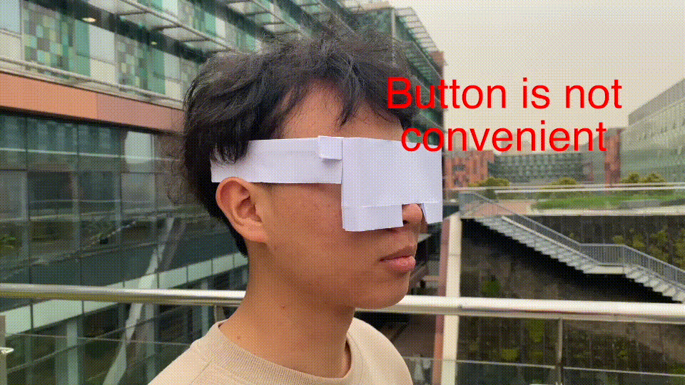
Physical buttons
Not easy to find
It is possible that the buttons will be tough to find.

Slide 4
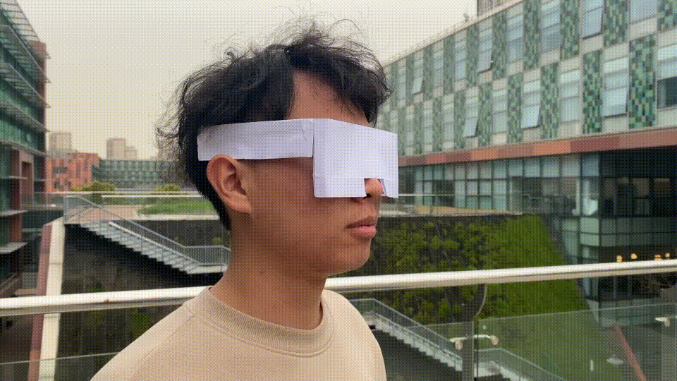
virtual touch button
wider range of recognition
Interactions
single-click
double-click
long press

Slide 5
Voice interaction
easier
Inconvenient
in the place that need to be quiet

Slide 6
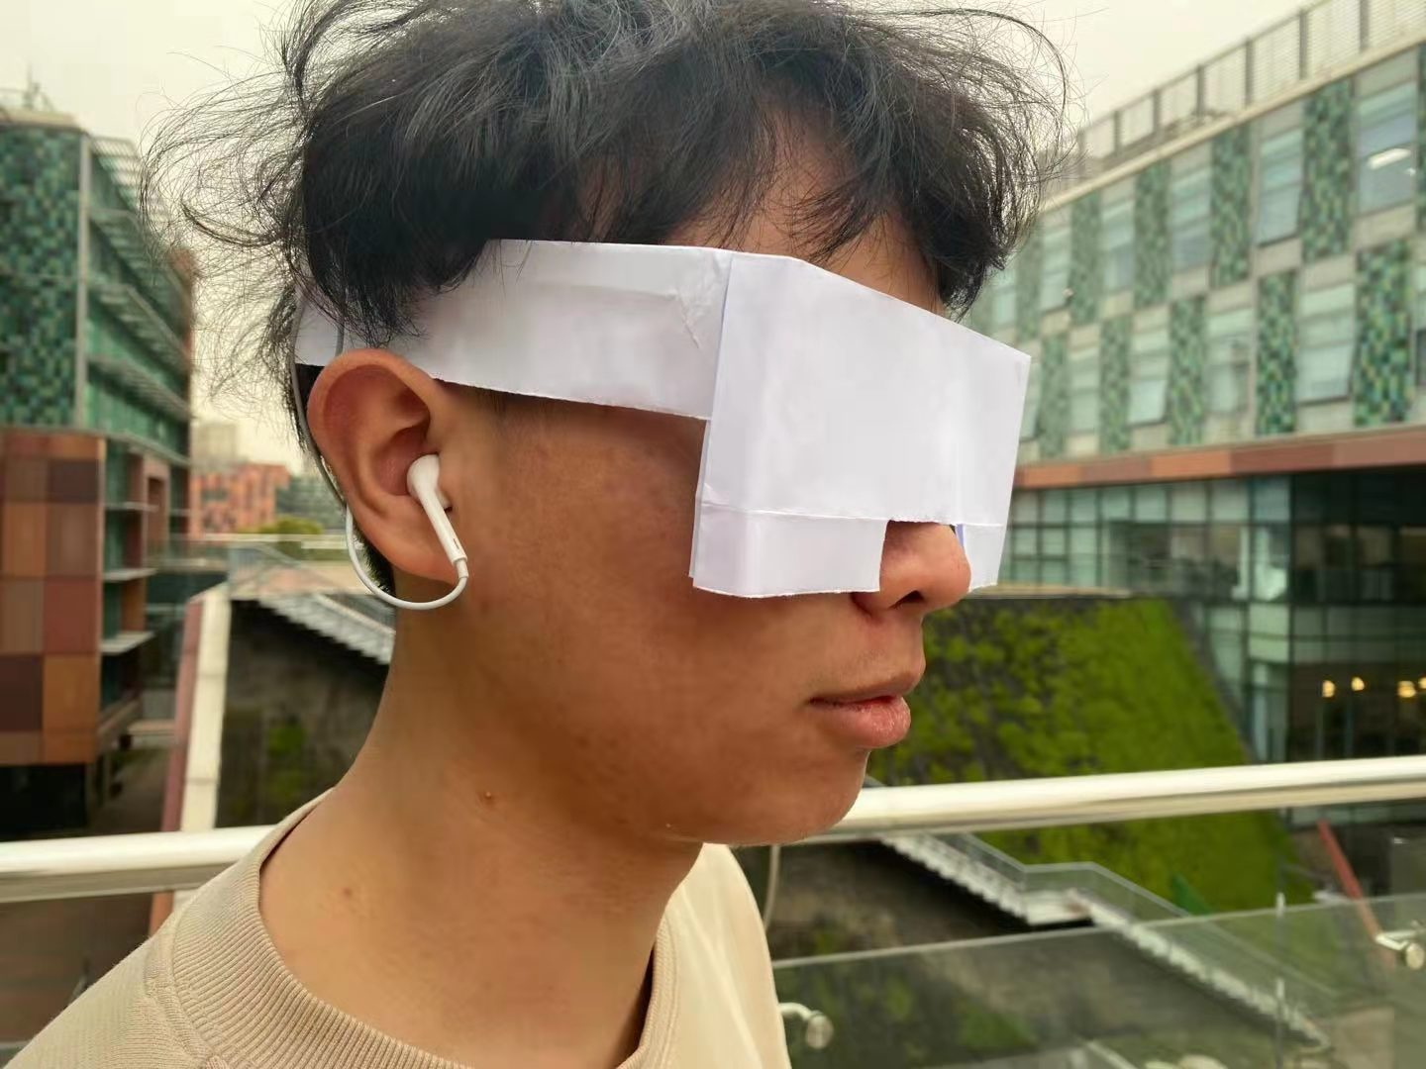
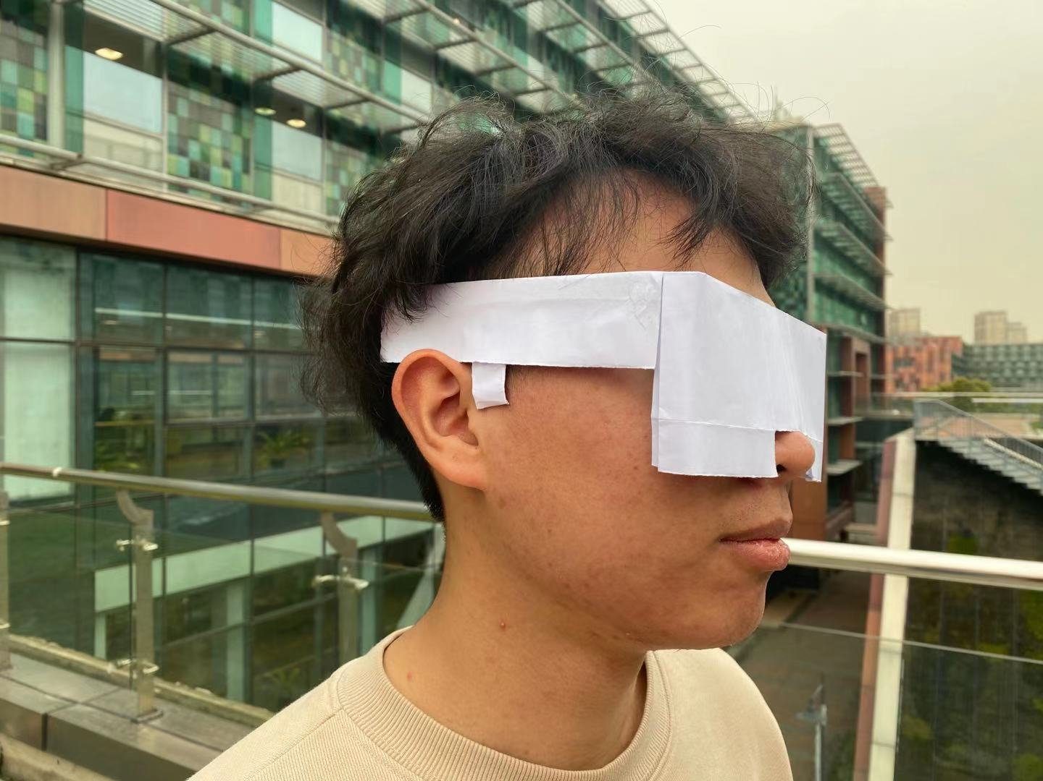
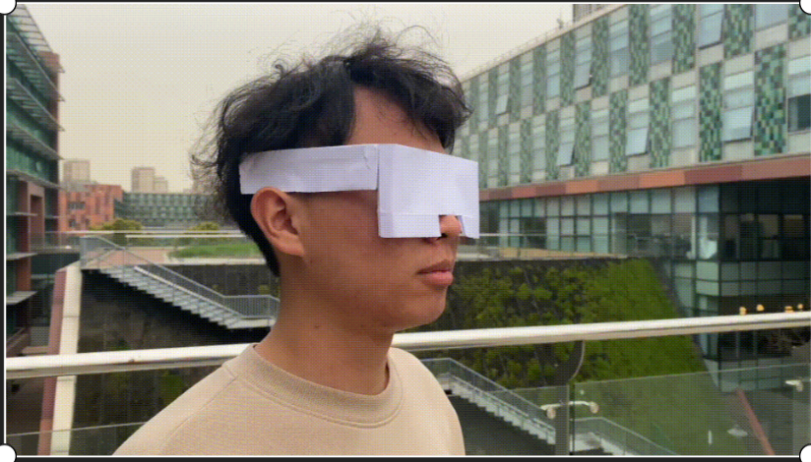
Three prototypes of receive information
In-ear headphones
Bone conduction earphones
Loudspeaker

Slide 7
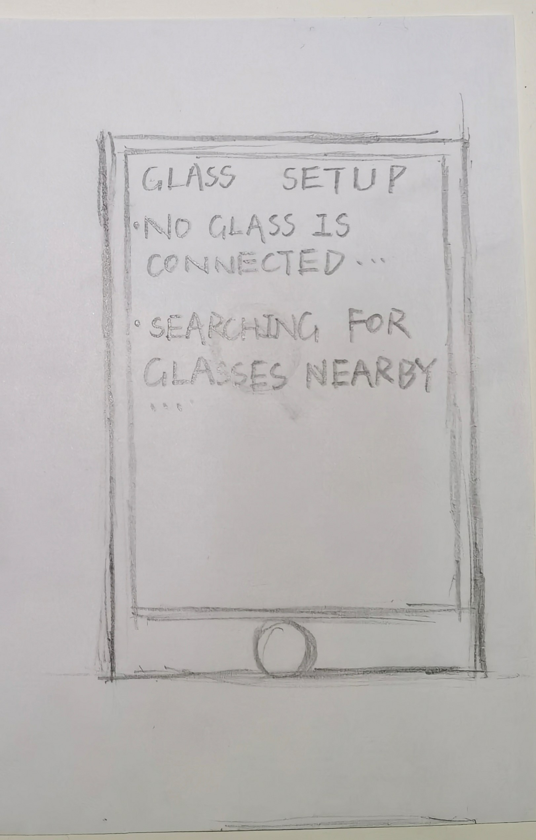
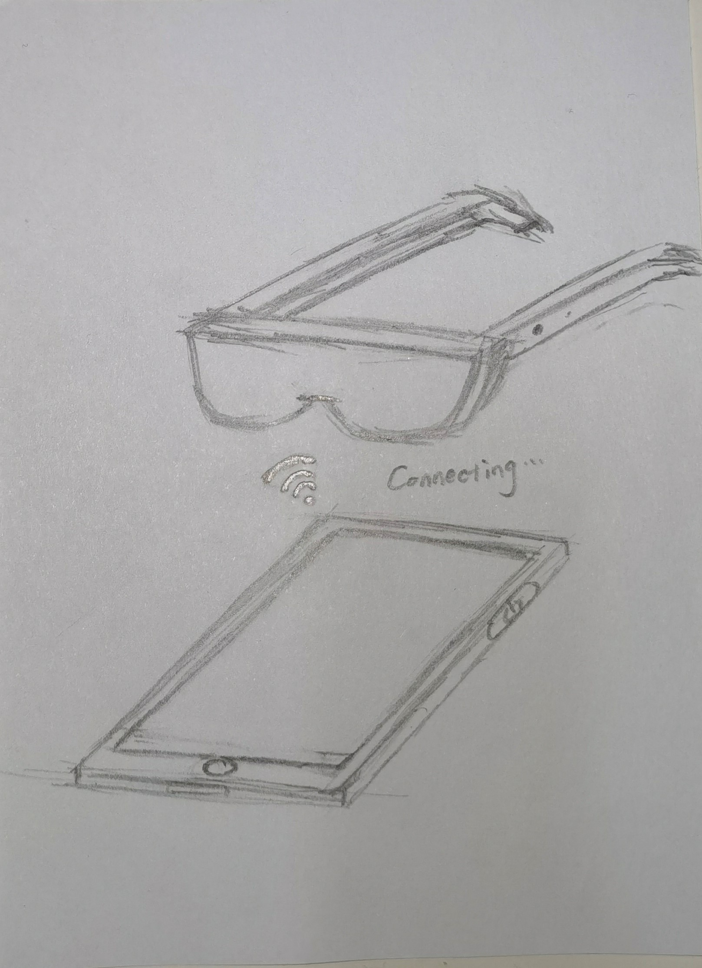
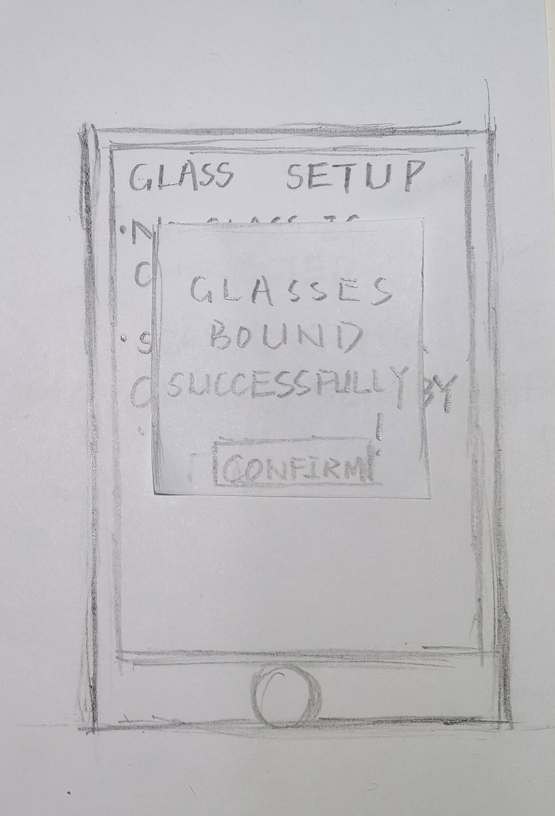
Our UI prototype
Connect

Slide 8
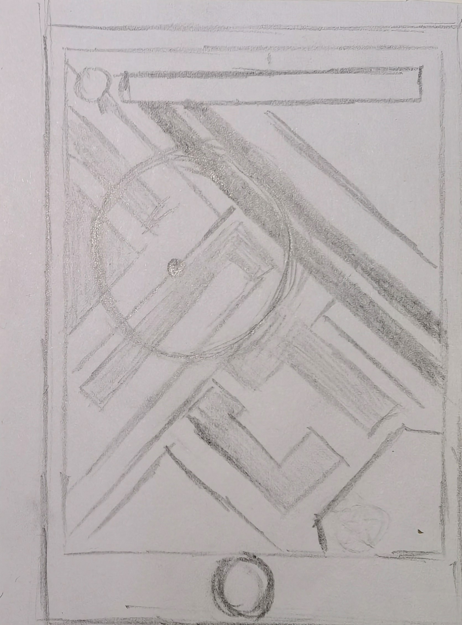
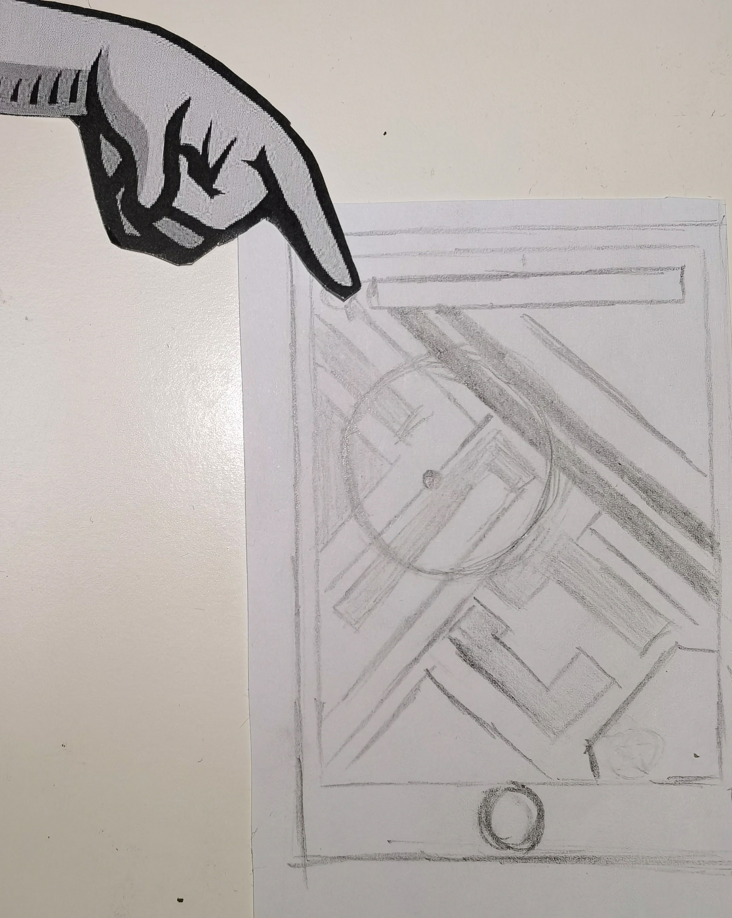
Enter the navigation screen
Use the Blind Mode in the Mobile Phone tell the user where the finger is

Slide 9
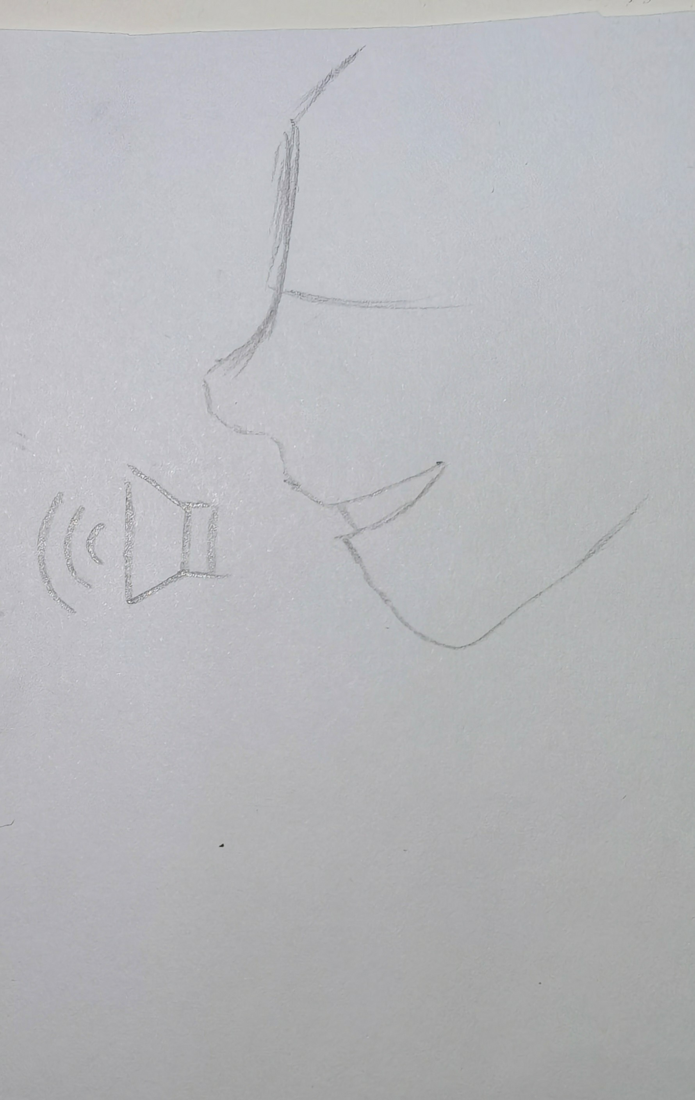
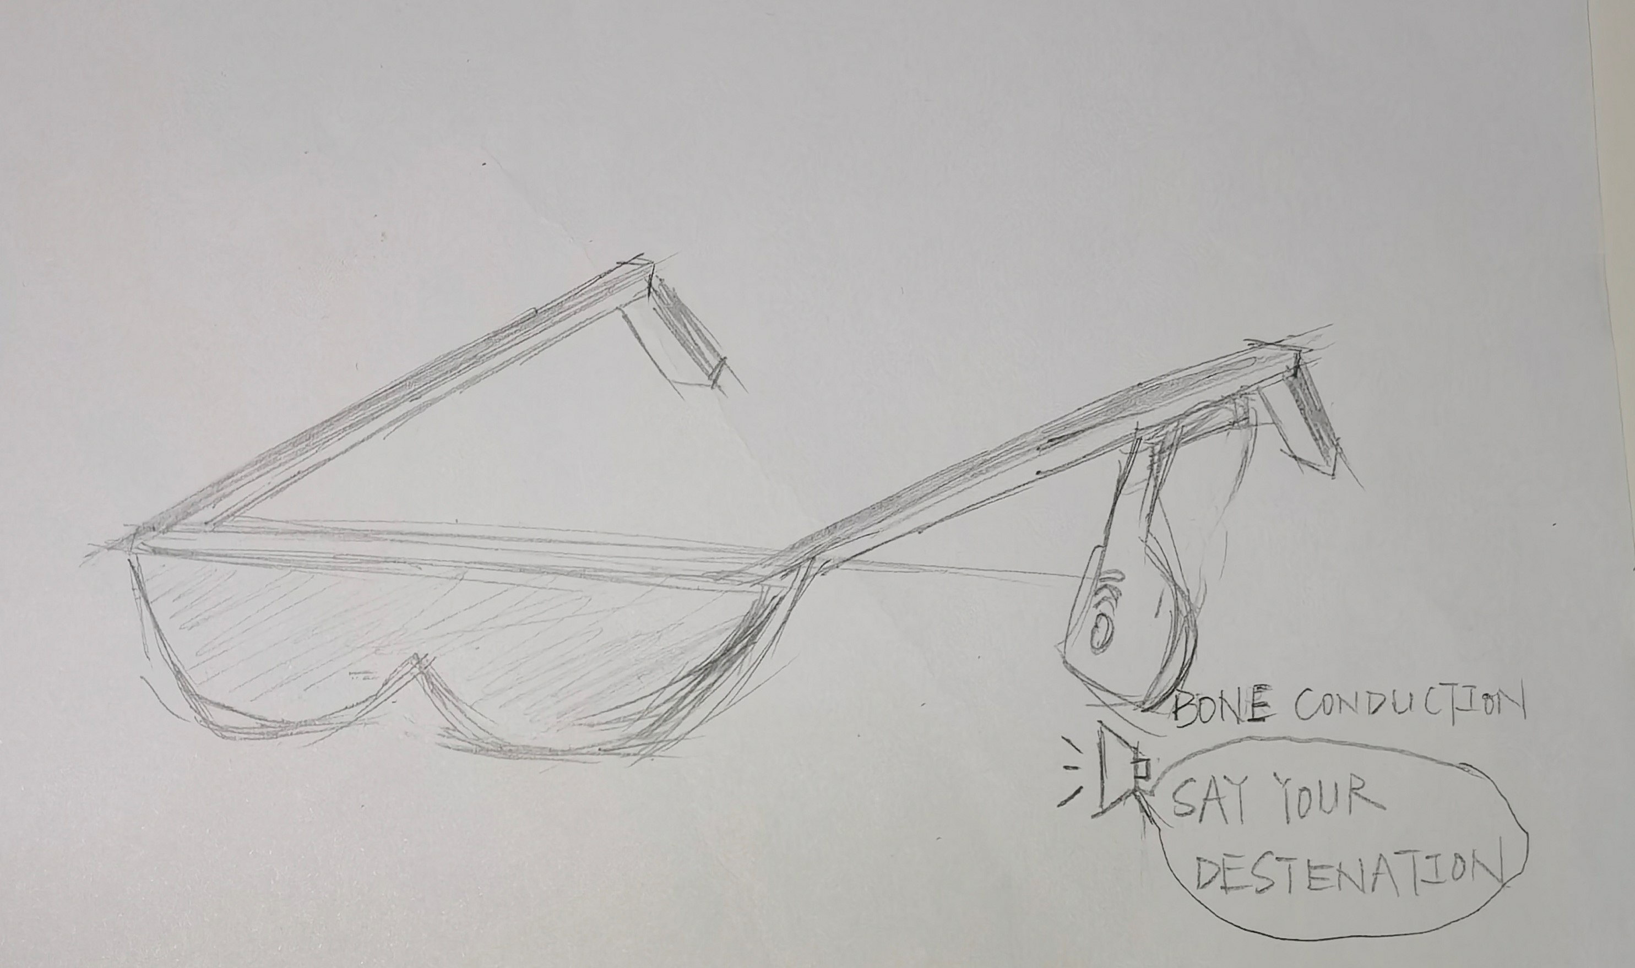
Through speech and bone conduction

Slide 10
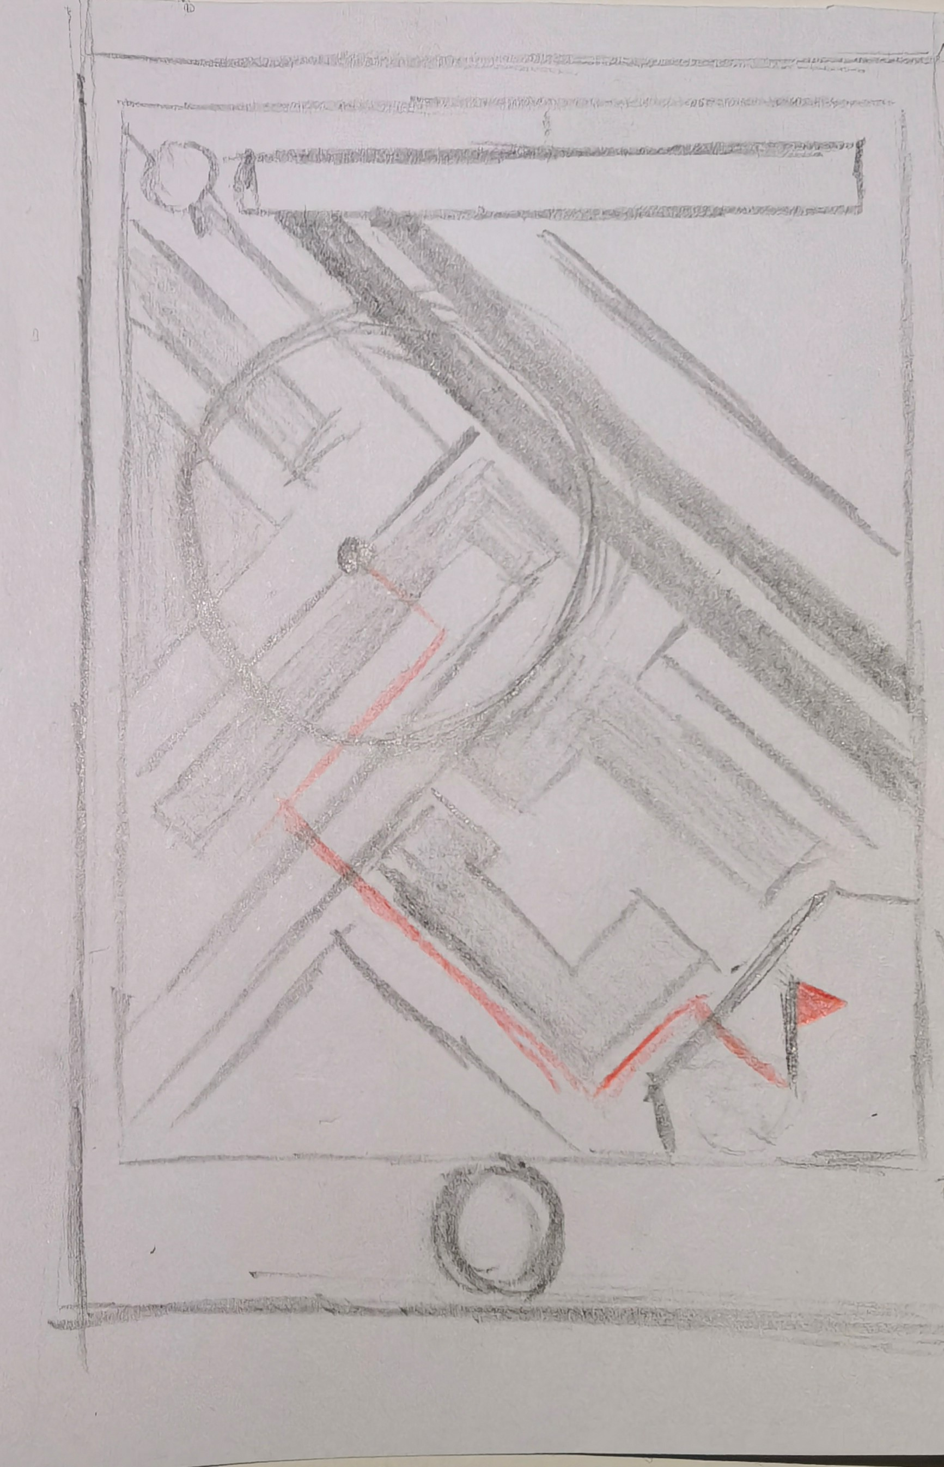
Use voice interaction to plan the route
It will be marked on the map

Slide 11
Conclusion
The primary advantage of prototyping is that it helps developers understand some of the customer's uncertain requirements.
It helps the customer easily implement the required changes before the final implementation of the system.
Errors can be detected earlier.

